Slide 1
Applied Statistics for AI (CMAI 6203 ) Week-3 Lecture-5
Topic : data Collection and Sampling Introduction

Slide 2
Learning Outcomes
Student will able to learn about:
Basic concept of Sampling.

Slide 3
Basic Terminologies in Data collection
In the context of Artificial Intelligence and Machine Learning, population and sample are foundational concepts used to describe the datasets required to train and evaluate models.
Population: This represents the entire possible set of data points or entities that a model is intended to generalize to. For example, if you are building an AI to detect spam emails, the "population" is every email ever sent or that will be sent.

Slide 4
Sample: This is a specific subset of that population used for the actual training and testing of the AI model. Because it is impossible to train on every single data point in existence, researchers use high-quality samples to estimate the characteristics of the whole population.

Slide 5
Sampling
In the field of Artificial Intelligence, sampling refers to the strategic selection of a subset of data from a larger population. This process is essential for making massive datasets manageable, reducing computational costs, and ensuring that models generalize effectively to real-world scenarios.
Sampling techniques in AI are generally divided into two main categories: Probability Sampling and Non-Probability Sampling.

Slide 6
Aim of Sampling:
Aims of sampling :
Reduces cost of research (e.g. political polls)
Generalize about a larger population
In some cases (e.g. industrial production) analysis may be destructive, so sampling is needed

Slide 7
Specific Uses in AI
Genetic Algorithms: A "population" refers to a set of candidate solutions (chromosomes) in a specific generation, while "sampling" involves selecting individuals for reproduction.
Training & Test Sets: The data you feed into a model is a sample. If this sample is not an adequate representation of the population, the AI may suffer from sampling bias, leading to poor performance on real-world data (overfitting).
Synthetic Data: Advanced AI can learn the underlying distribution of a sample to generate "synthetic population data," which mimics the original dataset's properties at a much larger scale.

Slide 8
Why Data Sampling Matters in AI
AI models rely on quality data to learn patterns and make decisions.
Collecting and processing all data is often impossible due to scale and cost.
Sampling selects a smaller, representative subset to train efficient, accurate models.

Slide 9
The Challenge: Representativeness & Bias
Poor sampling leads to biased models that fail in real-world scenarios.
Example: Fraud detection models biased by majority class data miss rare fraud cases.
Goal: Ensure samples reflect the diversity and complexity of the full dataset.

Slide 10
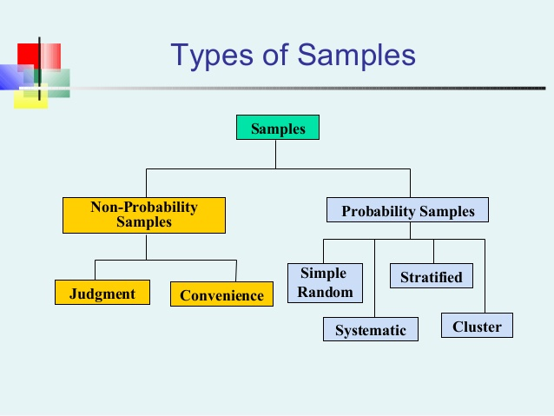
Types of sampling

Slide 11
Types of Sampling(brief Explaination)
1. Probability Sampling (Random Selection)
Probability sampling methods involve random selection, ensuring each data point has a known, non-zero chance of being chosen, which helps minimize bias.
Simple Random Sampling: Each data point has an equal chance of selection. While simple, it might miss rare data in imbalanced datasets.
Stratified Sampling: The population is divided into subgroups (strata), and samples are drawn from each to ensure proportional representation, useful for capturing rare events.

Slide 12
Systematic Sampling: Data is selected at fixed intervals from an ordered list. It's efficient but can be biased by hidden patterns.
Cluster Sampling: The population is divided into clusters, and entire clusters are randomly selected.
Multistage Sampling: A variation of cluster sampling involving further division of groups before the final sample is taken.

Slide 13
Non-Probability Sampling (Subjective Selection)
These methods are based on judgment or convenience rather than random selection, making them more prone to bias but often faster.
Convenience Sampling: Using readily available data.
Purposive (Judgmental) Sampling: Selecting data based on specific criteria or expert knowledge.
Quota Sampling: Selecting data to meet predetermined proportions for different categories.
Snowball Sampling: Participants recruit others from their network, useful for hard-to-reach populations.

Slide 14
Real-World Impact: Sampling Boosts AI Performance
Proper sampling reduces computational costs drastically.
Enhances model generalization and robustness on unseen data.
Enables AI applications in healthcare, finance, and autonomous systems.

Slide 15
Conclusion: Sampling is the Foundation of Effective AI
Thoughtful data sampling transforms raw data into AI-ready insights.
Combining classical and AI-driven sampling techniques unlocks model potential.
Mastering sampling is key to building fair, efficient, and powerful AI systems.

Slide 16
Advanced Techniques: Oversampling & Under sampling
Oversampling duplicates minority class data to balance datasets.
Undersampling reduces majority class data to prevent bias.
Hybrid methods combine both for imbalanced AI tasks like anomaly detection.
Example: SMOTE algorithm generates synthetic minority samples.

Slide 17
References
Probability and Statistics for Engineers and Scientists by Ronald E. Walpole, Raymond H. Myers, Sharon L. Myers and Keying E. Ye, Pearson; 9th Edition (January 6, 2011). ISBN-10: 0321629116 2
Walpole, P.E., Myers R.H., Myers S.L. (1998), “Probability and Statistics for Engineers and Scientists”, 7th Ed. Prentice Hall.

